Slide 1
Outline
n Importance of Resource Management
n What is Project Resource Management?
n Keys to Managing and Leading People
n Six Main Processes
1. Developing Resource Management Plan and Team Charter
2. Estimating Activity Resources
3. Acquiring Resources
4. Developing the Project Team
5. Managing the Project Team
6. Controlling Resources
n Using Software to Assist in Resource Management
2

Slide 2

1. Develop Resource Management Plan
(R.M.P.) and Team Charter
n Developing an R.M.P. involves identifying and documenting project resources, roles, responsibilities, skills, and reporting relationships
Include a human resource management plan and a physical resource management plan
n Content of an R.M.P.
i. Project organizational charts: specify roles and reporting relationships
ii. Responsibility assignment matrices: specify the detailed roles and responsibilities of project team
iii. Staffing management plan and resource histograms
iv. Team charter: guide how the project team will operate
n To create an R.M.P., top management and project manager must identify what types of people the project needs to ensure success
3

Slide 3

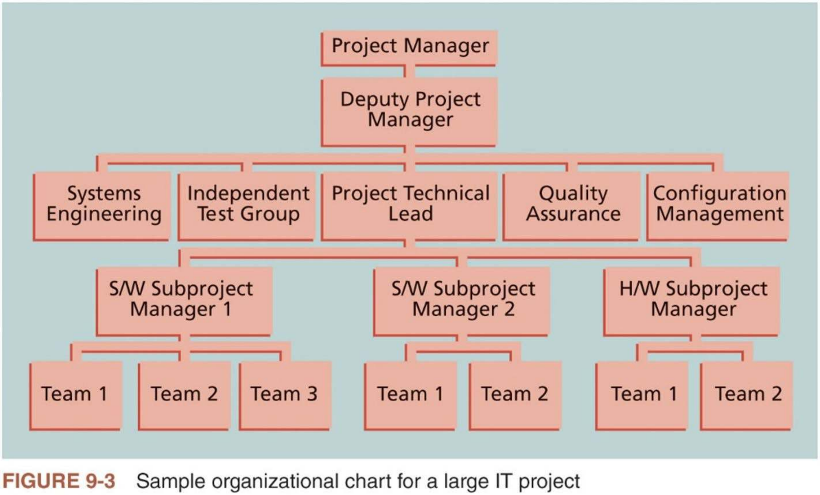
Project Organizational Charts (1 of 3)
n Provide a clear organizational structure for a project
Project manager should work with top management and project team to create an organizational chart for the project
4

Slide 4

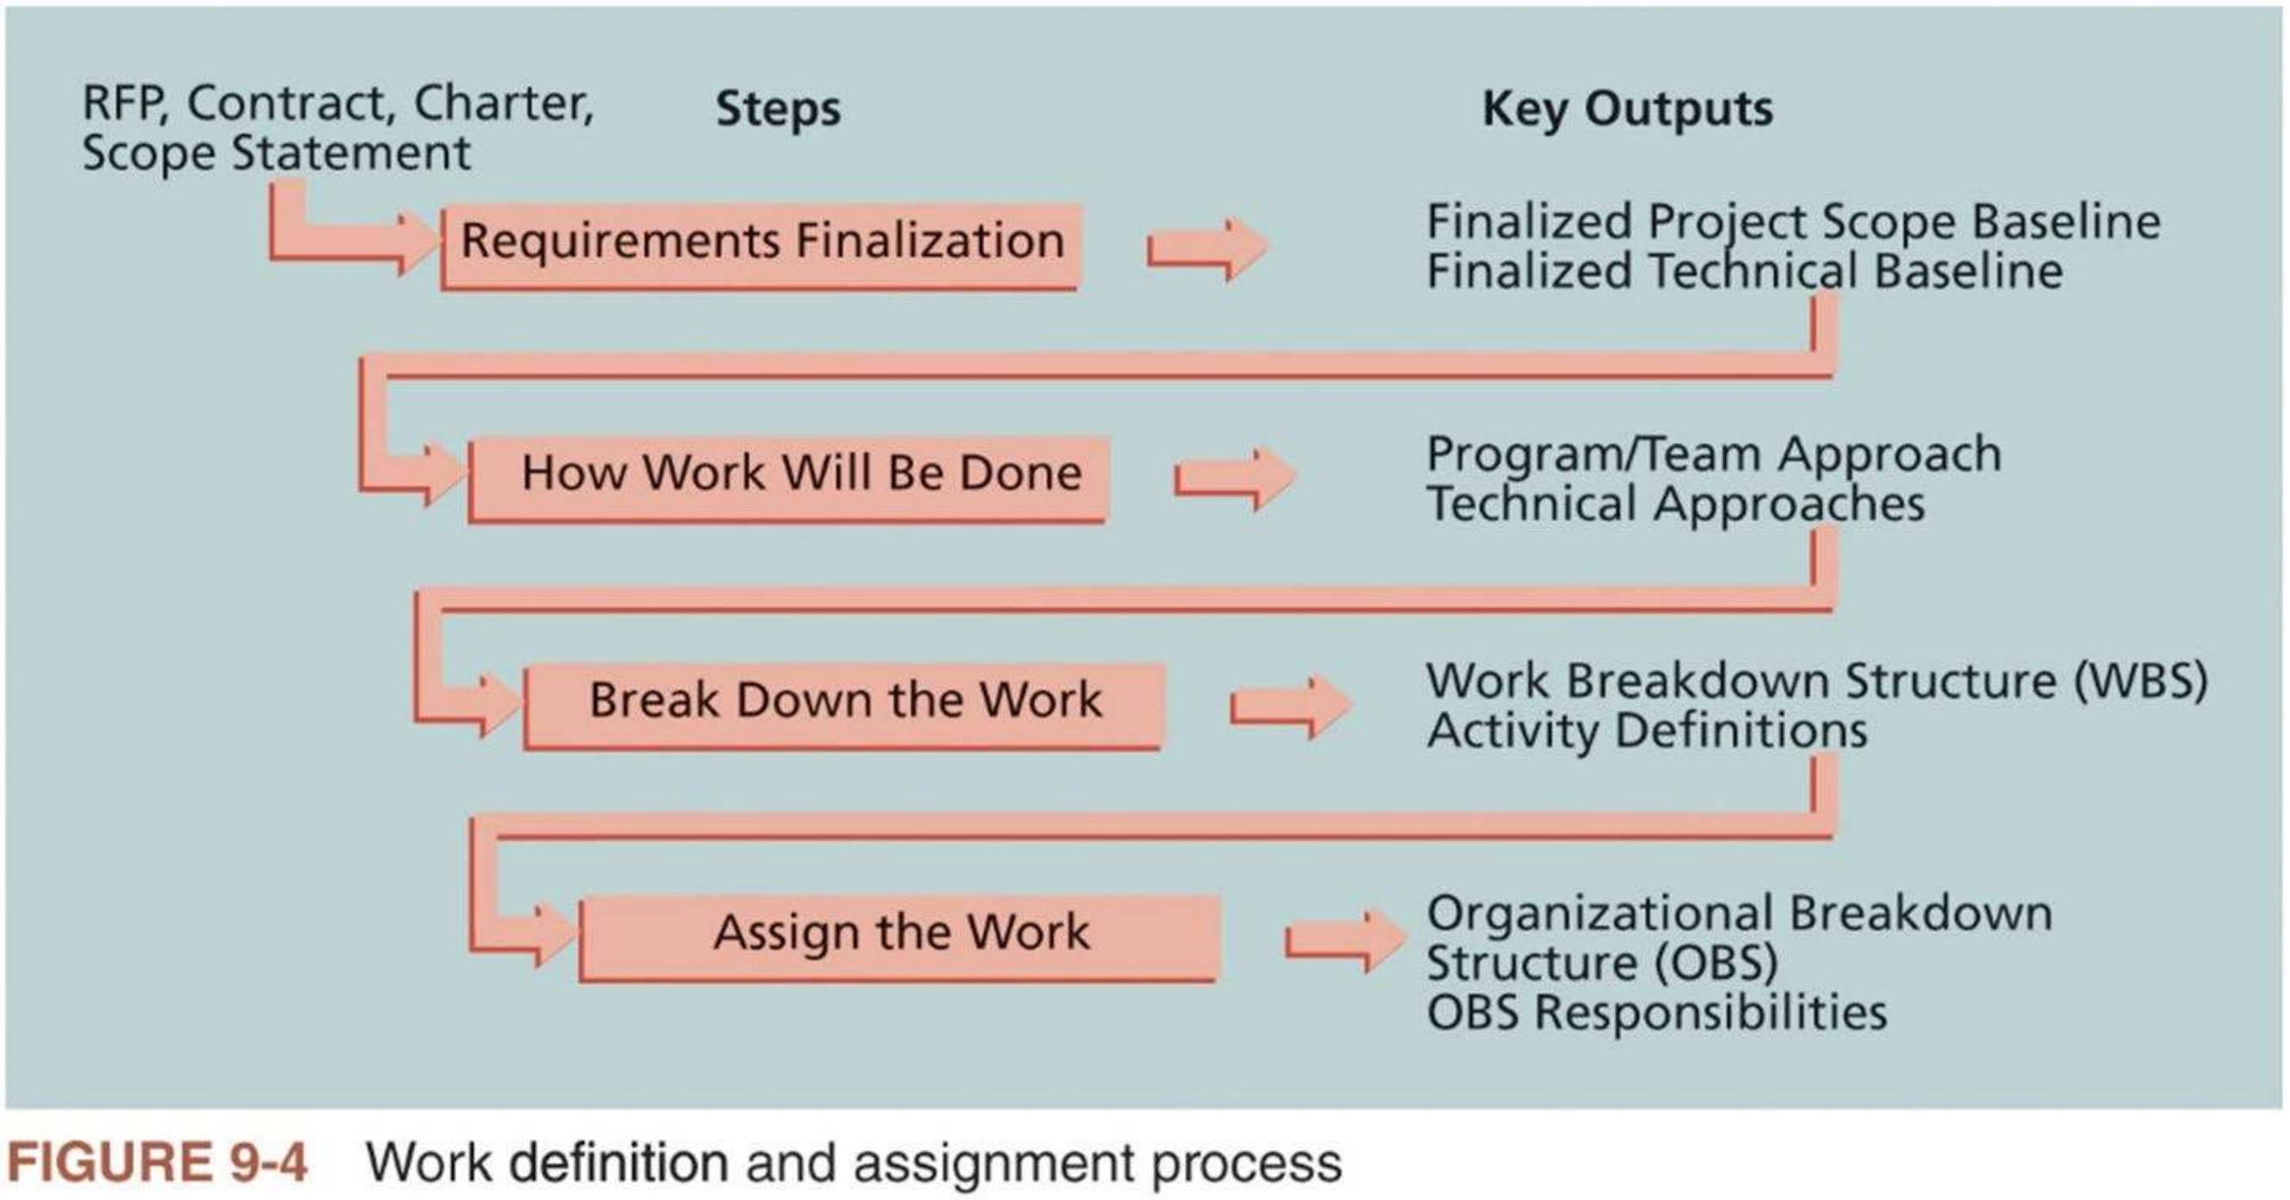
Project Organizational Charts (2 of 3)
n Important to follow a work definition and assignment process, which is carried out during the proposal and startup phases ofa project
Figure 9-4 provides a framework for defining and assigning work that consists of four steps:
5

Slide 5

Project Organizational Charts (3 of 3)
n Once the work has been broken down into manageable elements, the project manager assigns work to organizational units
Often based on where the work fits in the organization
n Project manager uses an organizational breakdown structure (OBS) to conceptualize the process
A specific type of organizational chart showing which organizational units are responsible for which work items
OBS can be based on a general organizational chart and then broken down into more detail, based on specific units in the company or subcontracted companies.
n After developing an OBS, project managers can develop a responsibility assignment matrix
6

Slide 6
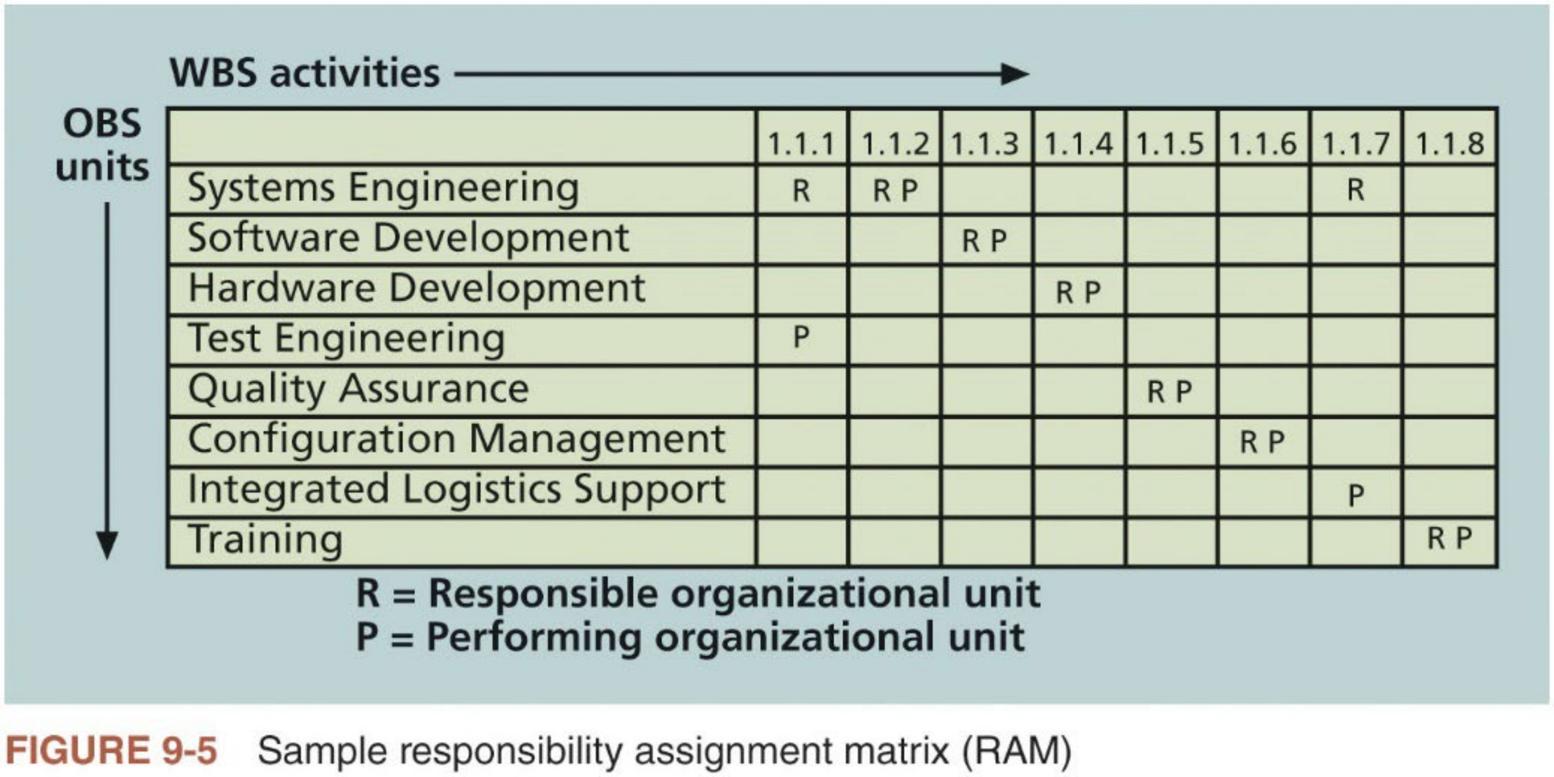
Responsibility Assignment Matrices (1 of 3)
n Responsibility assignment matrix (RAM) maps the work of the project, as described in the WBS, to the people responsible for performing the work, as described in the OBS.
7

Slide 7

Responsibility Assignment Matrices (2 of 3)
n RAM allocates work to responsible and performing organizations, teams, or individuals, depending on the desired level of detail
n RACI charts, another type of RAM, show four key roles for project stakeholders:
i. Responsibility: Who does the task?
ii. Accountability: Who signs off on the task or has authority for it?
iii. Consultation: Who has information necessary to complete the task?
iv. Informed: Who needs to be notified of task status and results?
n RACI charts list tasks vertically and individuals or groups horizontally
Each intersecting cell contains “R”, “A”, “C”, or “I”
A task may have multiple “R”, “C”, or “I” entries, but there can be only one “A” entry per row to clarify who is accountable for each task.
8

Slide 8


Responsibility Assignment Matrices (3 of 3)
n Table 9-2 shows a sample RACI chart
In the bottom row, a mechanic is responsible for repairing a car, but the shop owner is accountable for the repairs being made properly.
The car owner and parts supplier would be other stakeholders with various roles for different work activities.
RACI charts show the roles different organizational units or specific stakeholders have in getting the work done
 | Car Owner | Shop Owner | Mechanic | Parts Supplier
Pay for parts and services | A, R | C
Determine parts and services needed | C |  | A, R | C
Supply parts |  | C | C | A, R
Install parts | I | A | R
Table 9-2 Sample RACI chart
9

Slide 9


Staffing Management Plans and Resource
Histograms (1 of 2)
n Staffing management plan (S.M.P.) describes when and how people will be added to the project team and taken off it
For example, the S.M.P. of a one-year IT project may describe the types and the numbers of people needed to work on the project each month. It may also describe how these resources would be acquired, trained,
rewarded, and reassigned after the project.
n Resource histogram is a column chart showing the number of human or physical resources assigned to a project over time
Figure 9-6 provides an example of a histogram that might be used for a six- month IT project
n After determining the resource needs, the next step in project resource management is to acquire resources.
10

Slide 10
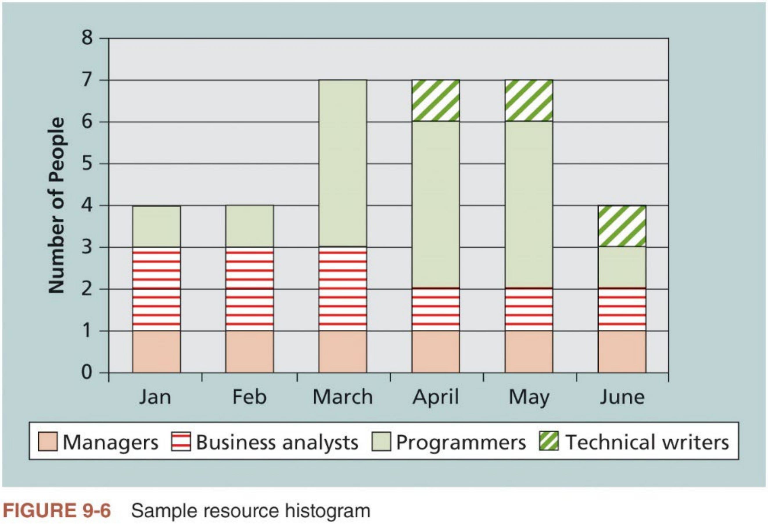
Staffing Management Plans and Resource Histograms (2 of 2)
11

Slide 11

Team Charters
n Used to promote teamwork and clarify team communications
n After core project team members have been selected, they meet to prepare a team charter to guide how the team will function
Project manager should attend the meeting and act as a facilitator
Crucial to emphasize the importance of the project team throughout the project’s life cycle, and update the team charter as needed
n Content of a team charter
i. Team values
ii. Communication guidelines
iii. Decision-making criteria and process
iv. Conflict resolution process
v. Meeting guidelines
vi. Team agreements
12

Slide 12
2. Estimate Activity Resources (1 of 2)
n The people who estimate activity resources must have experience and expertise in similar projects and with the organization performing the project
n Important questions to answer when estimating activity resources (refer to textbook for a full list)
i. How difficult will specific activities be on this project?
ii. Is anything unique in the project’s scope statement affecting resources?
iii. Has the organization done similar tasks before?
iv. Does the organization have people, equipment, and materials that are capable and available for performing the work?
n Answering these questions requires important inputs such as the PM plan, project documents, enterprise environmental factors, and organizational process assets
13

Slide 13




2. Estimate Activity Resources (2 of 2)
n Main outputs
A list of activity resource requirements
A basis of estimates
A resource breakdown structure: a hierarchical structure that identifies the project’s resources by category and type
Project document updates
n Important to thoroughly brainstorm and evaluate alternatives related to resources, especially on projects that involve people from multiple
disciplines and companies
n Estimating activity resources provides the basis for estimating activity durations and vital information for project cost estimates, and project communications, risk and procurement management
14

Slide 14
3. Acquire Resources
n Acquiring qualified IT professionals is critical as many organizations today face a shortage of IT staff
“The project manager who is the smartest person on the team has done a
poor job of recruiting.”
n Also, important to acquire the necessary physical resources (facilities, equipment, supplies, etc.) and provide the right type of resources at the right time and place
n Three related topics
1. Resource assignment
2. Resource loading
3. Resource leveling
15

Slide 15



Resource Assignment
n Project managers must work with other people in their organizations to assign them to their projects or to acquire additional human or physical resources needed for the project
Important to have good staffing plans and procedures for recruiting new employees and hiring subcontractors
n Project managers must work with H.R. managers to address any problems in recruiting and retaining IT staff
For example, offer incentives to existing employees for helping recruit and retain personnel, and provide benefits based on personal need
Important to consider the needs of individuals and organization when
making recruiting and retention decisions, and to study the best practices of leading companies in these areas
16

Slide 16



Resource Loading (1 of 2)
n Resource loading refers to the amount of individual resources an existing schedule requires during specific time periods
It provides a general understanding of the demands a project will make on the organization’s resources and individual people’s schedules
n Resource histogram depicts period-by-period variations in resource loading and shows when work is overallocated to resources
Very helpful in determining resources needs or identifying staffing problems
Figure 9-7 shows a sample resource histogram
n Over-allocation means NOT enough resources are available to perform the assigned during a given time period
Often result from poor estimates of how many hours are required to accomplish work
Unrealistic to assume all workers are productive 100% of time
17

Slide 17
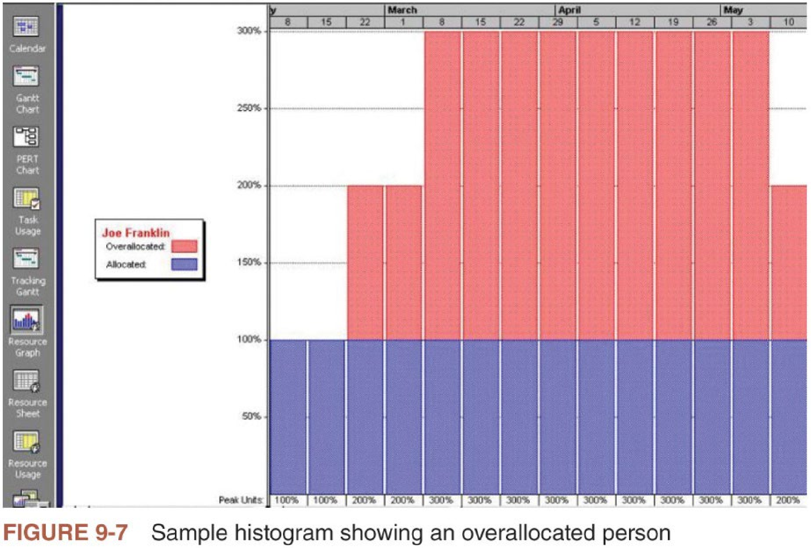
Resource Loading (2 of 2)
18

Slide 18
Resource Leveling (1 of 2)
n A technique for resolving resource conflicts by delaying tasks and creating a smoother distribution of resource usage
Ifa certain resource is over-allocated (or under-allocated), then change the schedule to remove resource over-allocation (or improve its usage)
n Figure 9-8 illustrates an example of resource leveling
n Benefits of resource leveling
i. Require less management when resources are used more constantly
ii. May enable project managers to use a just-in-time inventory type of policy for using subcontractors or other expensive resources
iii. Results in fewer problems for project personnel and accounting
iv. Often improve morale
n PM software can automatically level resources, but project managers must be careful in using the results
19

Slide 19
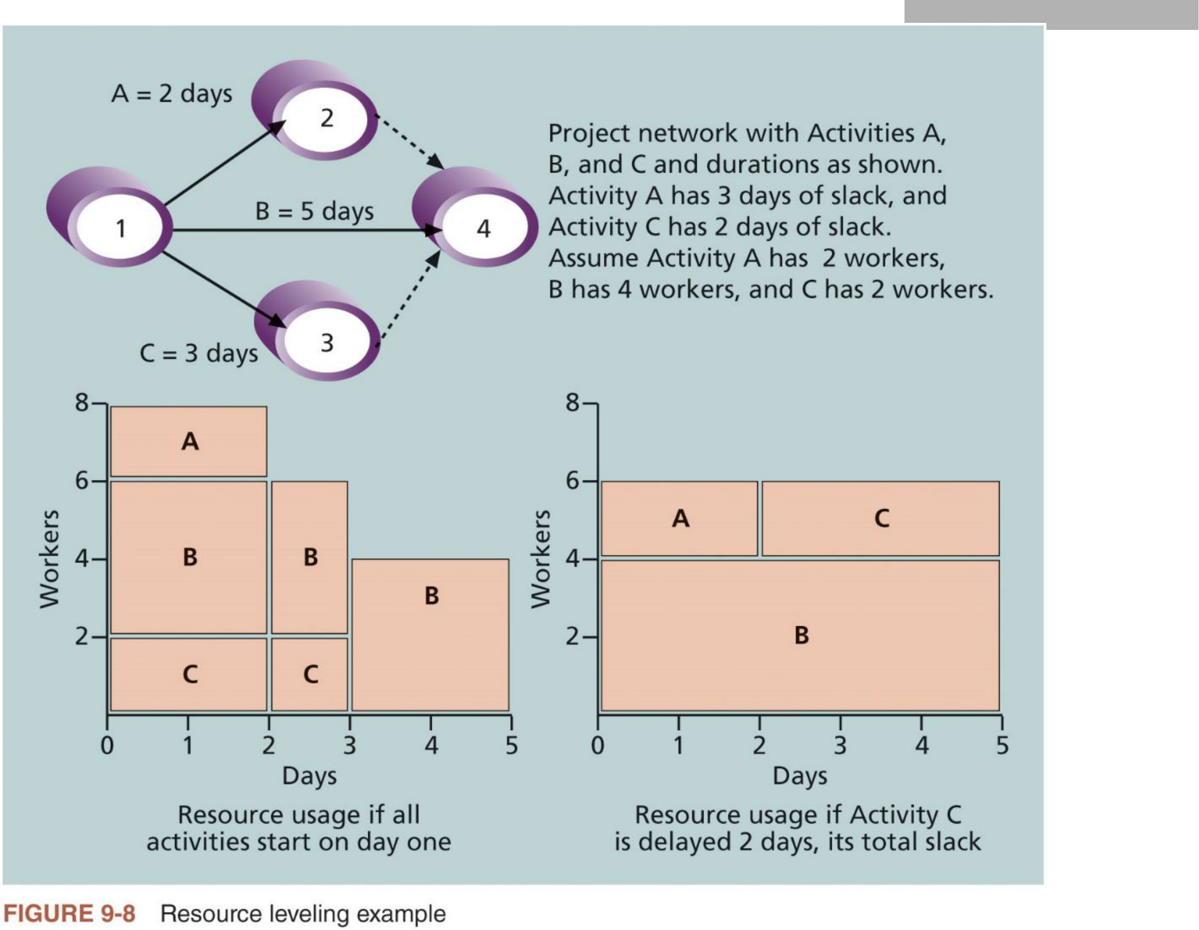
Resource Leveling (2 of 2)
20

Slide 20
4. Develop the Project Team (1 of 3)
n Main Goal: help people work together more effectively to improve project performance
n Project managers must ensure that people work together as a team to achieve project goals
Many IT projects have talented people working on them, but it takes teamwork to complete most projects successfully
n Tuckman model of team development
1. Forming involves the introduction of team members, either at the initiation of the team or as new members are introduced.
2. Storming occurs when team members have different opinions for how the
team should operate. People test each other, and there is often conflict within the team.
21

Slide 21
4. Develop the Project Team (2 of 3)
3. Norming is achieved when team members have developed a common
working method. Cooperation and collaboration replace the conflict and mistrust of the previous phase.
4. Performing occurs when the emphasis is on reaching the team’s goals rather than working on team process. Relationships are settled, and team members are likely to build loyalty toward each other.
5. Adjourning involves the break-up of the team after it successfully reaches its goals and completes the work
n Three techniques for team development
1. Training
2. Team-building activities
3. Reward and recognition systems
22

Slide 22
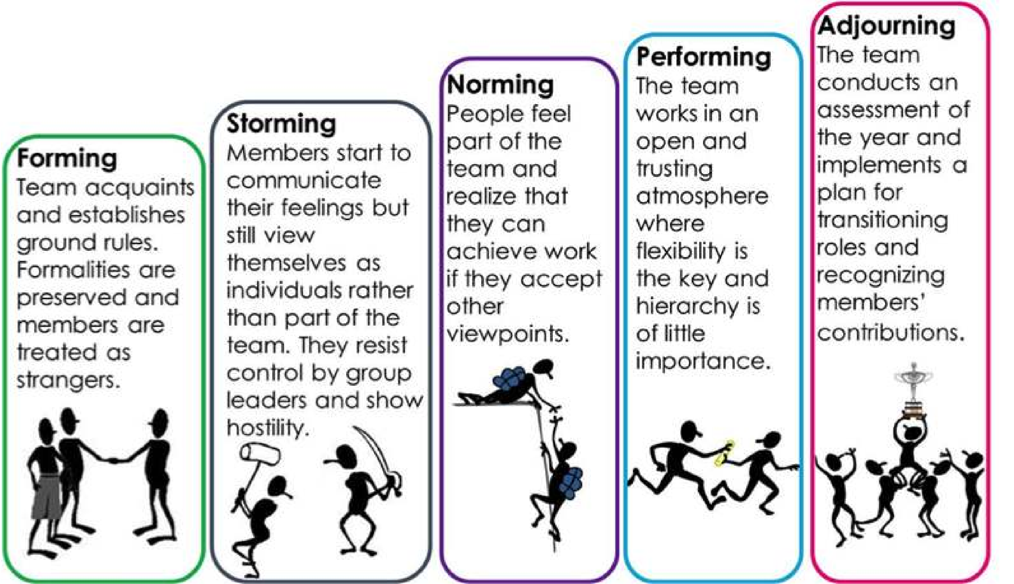
4. Develop the Project Team (3 of 3)
Tuckman Model of Team Development
23

Slide 23


Training
n Project managers often recommend that people take specific training courses to improve individual and team development
Very important to provide training in a just-in-time fashion. For example, training to deal with difficult people helps much a new consultant, but not much a new programmer
n Many organizations provide e-learning opportunities for their employees so they can learn specific skills at any time and any place
e-learning is sometimes more cost-effective than traditional instructor-led training courses
Make sure that the timing and delivery method for the training is appropriate for specific situations and individuals
n Often more economical to train current employees in particular areas than to hire new people who already possess those skills
24

Slide 24
Team-building activities
n Two common approaches to team-building activities
1. Physical challenges (e.g., hiking, bicycling, boating, rock climbing)
2. Psychological preference indicator tools
n Physical challenges can help teams of strangers to work together more
effectively, but can cause more problems for already dysfunctional teams
n Mental team-building activities help teams learn about themselves, each other, and how to work as a group most effectively
Important for people to understand and value each other’s differences to work effectively as a team
Three common exercises (refer to textbook or linked webpages)
i. Myers-Briggs Type Indicator (MBTI): determine personality preferences
ii. Wilson Learning Social Styles Profile: test behavioral profiles
iii. DISC Profile: test people’s behavioral tendencies under certain situations
25

Slide 25
Reward and Recognition Systems
n If management rewards teamwork, they will promote or reinforce the philosophy & culture that people work more effectively in teams
Some organizations offer bonuses, trips, or other rewards to workers who meet or exceed company or project goals
n Project managers can recognize and reward people who willingly work overtime to meet an aggressive schedule objective or go out of their way to help a teammate (why?)
Should NOT reward people who work overtime just to get extra pay or because of their own poor work or planning (why?)
n Project managers must continually assess their team’s performance and find the best way to develop their people and improve performance
26

Slide 26


5. Manage the Project Team
n Besides developing their teams, project managers must lead them to perform various project activities
n After assessing team performance and related information, the project manager must make decide
i. if changes should be requested to the project, or
ii. if updates are needed to enterprise environmental factors, organizational process assets, or the project management plan.
n Project managers must use their soft skills to find the best way to motivate and manage each team member
n Tools and techniques for managing project teams
Interpersonal and team skills (i.e., conflict management, decision making, emotional intelligence (E.I.), influencing, and leadership)
PM information systems
27

Slide 27
Conflict Management (1 of 3)
n Important for project managers to understand strategies for handling conflicts and to proactively manage conflict
n Five basic modes or strategies for handling conflicts by Blake and Mouton (1964)
1. Confrontation: face a conflict directly using a problem-solving approach
2. Compromise: use a give-and-take approach to resolving conflicts
3. Smoothing: de-emphasize (emphasize) areas of difference (agreement)
4. Forcing: win-lose approach to conflict resolution
5. Withdrawal: retreat or withdraw from an actual or potential disagreement
n More recent studies recognize a 6th mode
6. Collaborating: incorporate different viewpoints and insights to develop consensus and commitment
28

Slide 28

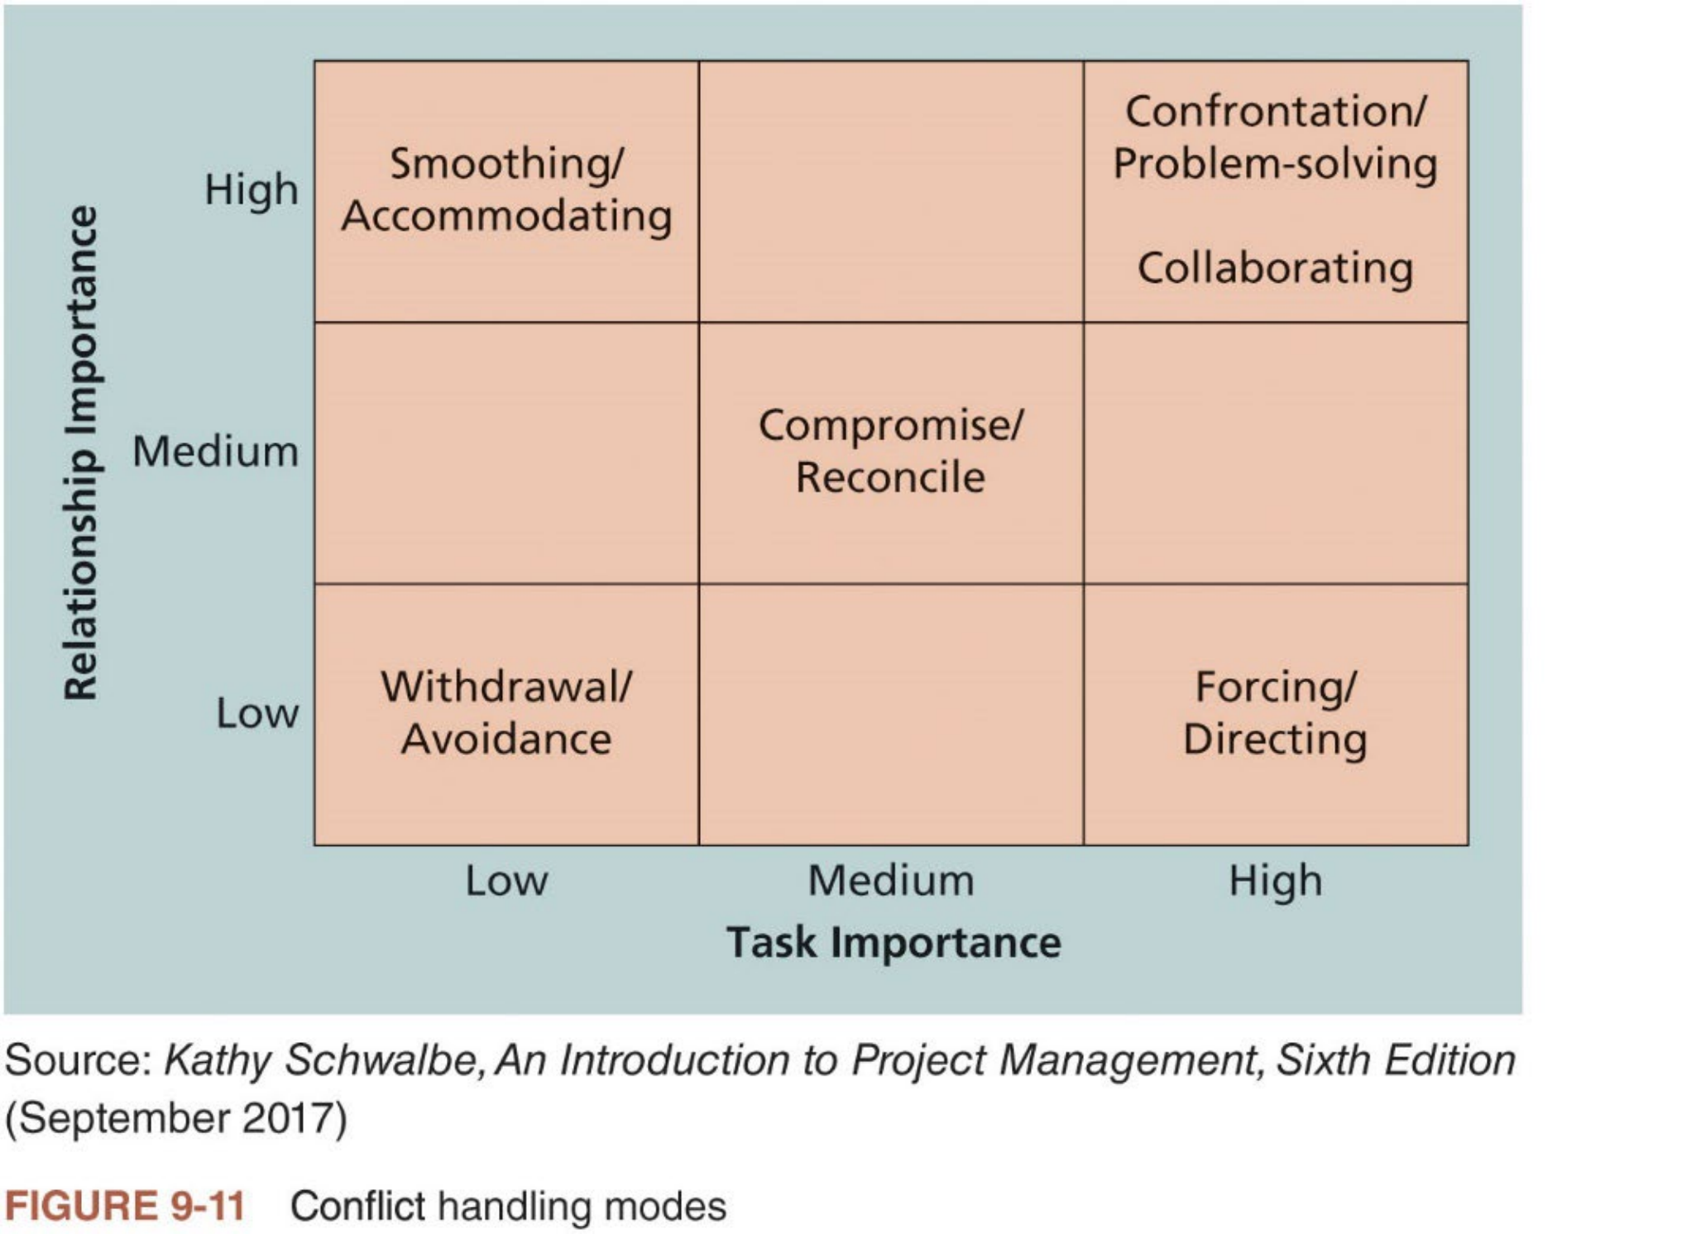
Conflict Management (2 of 3)
n Figure 9-11 shows the six conflict handling modes
Each mode has high, medium, low importance on two levels: important of the task or goal (or concern for production), and importance of the
relationship between the conflicting parties (or concern for people)
29

Slide 29
Conflict Management (3 of 3)
n Not all conflict are bad!
Conflict often produces important results, such as new ideas, better
alternatives, and motivation to work harder and more collaboratively
n Project team may become stagnant (停滞) or develop groupthink if there are no conflicting viewpoints
Groupthink: conformance to the values or ethical standards ofa group
n Task-related conflict, derived from differences over team objectives and how to achieve them, often improves team performance
n Emotional conflict, however, stemming from personality crashes and misunderstandings, often depresses team performance
n Project managers should create an environment that encourages and maintains the positive and productive aspects of conflict
30

Slide 30


General Advice on Managing Teams (1 of 2)
n Teamwork is challenging to create, and because teams are subject to dysfunction, maintaining teamwork is equally challenging
n Five dysfunctions of teams
i. Absence of trust
ii. Fear of conflict
iii. Lack of commitment
iv. Avoidance of accountability
v. Inattention to results
n Patrick Lencioni’s books provide suggestions for overcoming each of these dysfunctions
To master conflict, he suggests that teams practice having unfiltered, passionate debates about important issues.
To embrace accountability, he emphasizes the importance of clarifying and focusing on everyone’s top priorities.
31

Slide 31
General Advice on Managing Teams (2 of 2)
n Additional suggestions for ensuring productive teams (refer to textbook for a full list)
i. Be patient and kind with your team
ii. Fix the problem instead of blaming people
iii. Establish regular, effective meetings
iv. Allow time for teams to go through the basic team-building stages
v. Stress team identity
vi. Nurture team members and encourage them to help each other
vii. Acknowledge individual and group accomplishments
n Project managers must focus on empathically listening to other people to address their concerns and create an environment in which individuals
and teams can grow and prosper
32

Slide 32

6. Control Resources
n Ensure that the physical resources assigned to the project are available as planned
Also involves monitoring the planned versus actual resources utilization and taking corrective actions as needed
n Key outputs
Work performance information
Change requests
Project management plan updates
Project document updates
33

Slide 33

Use Software to Assist in Resource Management
n Spreadsheets or PM software such as Microsoft Project can help create RAM or resource histograms
n Microsoft Project provides a variety of resource management tools
Assigning and tracking resources
Leveling resources
Resource usage reports
Overallocated resource reports
To-do lists
n Read Appendix A: Brief Guide to Microsoft Project Professional 2016 for learning how to use some of these functions of Microsoft Project
n Project resource management involves much more than using software to facilitate organizational planning and assign resources
34

Slide 34
Complementary Reading
n Chapter 9 “Project Resource Management” of Schwalbe (2018)
n Chapter 9 “Project Resource Management” in Part 1 of PMBOK® Guide (2017)
35

